Slide 1
Further development of the mpshift module:
improved efficiency and enhanced functionality
Seminar über Theoretische Chemie 22. Juni 2017
Kevin Reiter

Slide 2

Further development of the mpshift module: status 06/2016
PB1: heavy elements (Z>36): relativistic core potentials
PB1a: Vibrational Circular Dichroism (VCD) spectra
PB2: environmental / solvent effects: COSMO-Model
PB3: efficiency: RI-J approximation
PB4: all electron relativistic (outlook at the 2nd period)

Slide 3
Further development of the mpshift module: status 06/2017
PB1: heavy elements (Z>36): relativistic core potentials
PB1a: Vibrational Circular Dichroism (VCD) spectra
PB2: environmental / solvent effects: COSMO-Model + point charge model, + Gaussian smeared charge model
PB3: efficiency: RI-J approximation + multipole-accelerated RI-J (MARI-J) approximation + linear scaling DFT routines (Fabian)
PB4: all electron relativistic (outlook at the 2nd period)

Slide 4
Environmental / solvent effects (PB2)

Slide 5
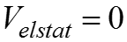
Environmental / solvent effects (PB2)
COnductor-like Screening Model (COSMO): - continuum solvation model - solute forms cavity within the dielectric continuum of permittivity ε - solute polarizes the dielectric medium → response is described by generation of screening charges Simulation of environmental / solvent effects by specification of on a shell around the molecule

Slide 6
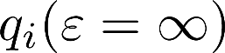
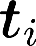
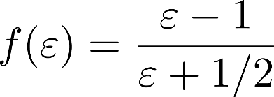
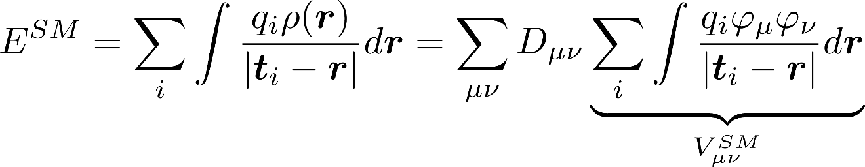
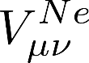
Environmental / solvent effects (PB2)
screening charges: on segments at position finite permittivity of real solvents → scaling by factor , with
Interaction energy: → same form as

Slide 7
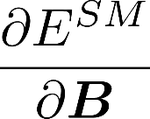
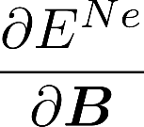
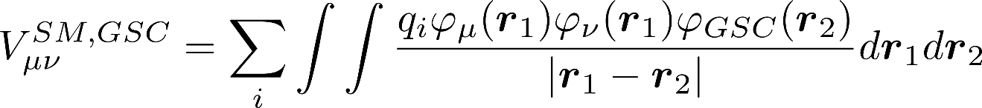
Environmental / solvent effects (PB2)
can be calculated with the same routines needed for
Same routine can be used for any point charges in gerneral → simple model to treat solvent effects with point charges
Alternative: Gaussian smeared charges → , see RI below

Slide 8
Environmental / solvent effects (PB2): application – acetone in water
Snapshots of acetone + water solvent molecules from MD-simulations (fixed structure parameters for acetone)
Different possibilities of solvent treatment
COSMO
model by point charges
model by Gaussian smeared charges
explicit calculation of water molecules
or combinations of b/c and d

Slide 9
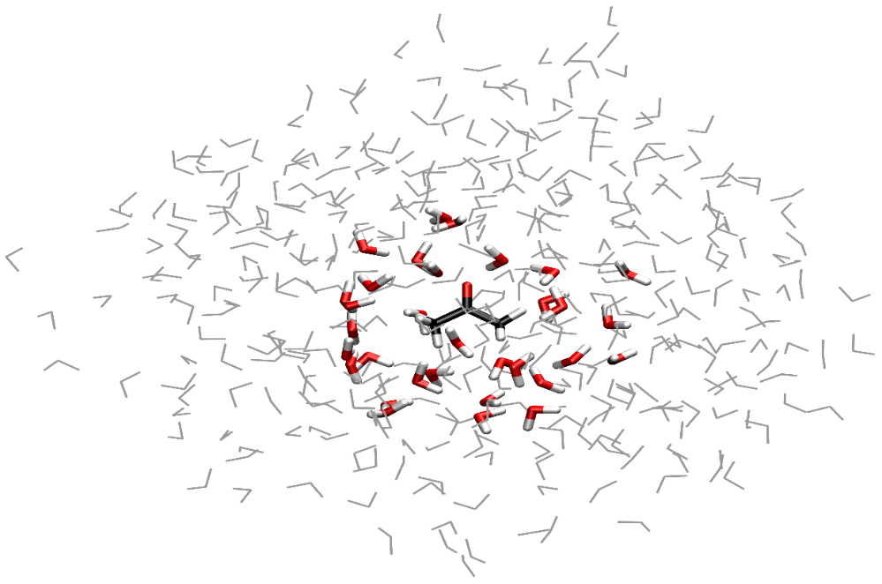
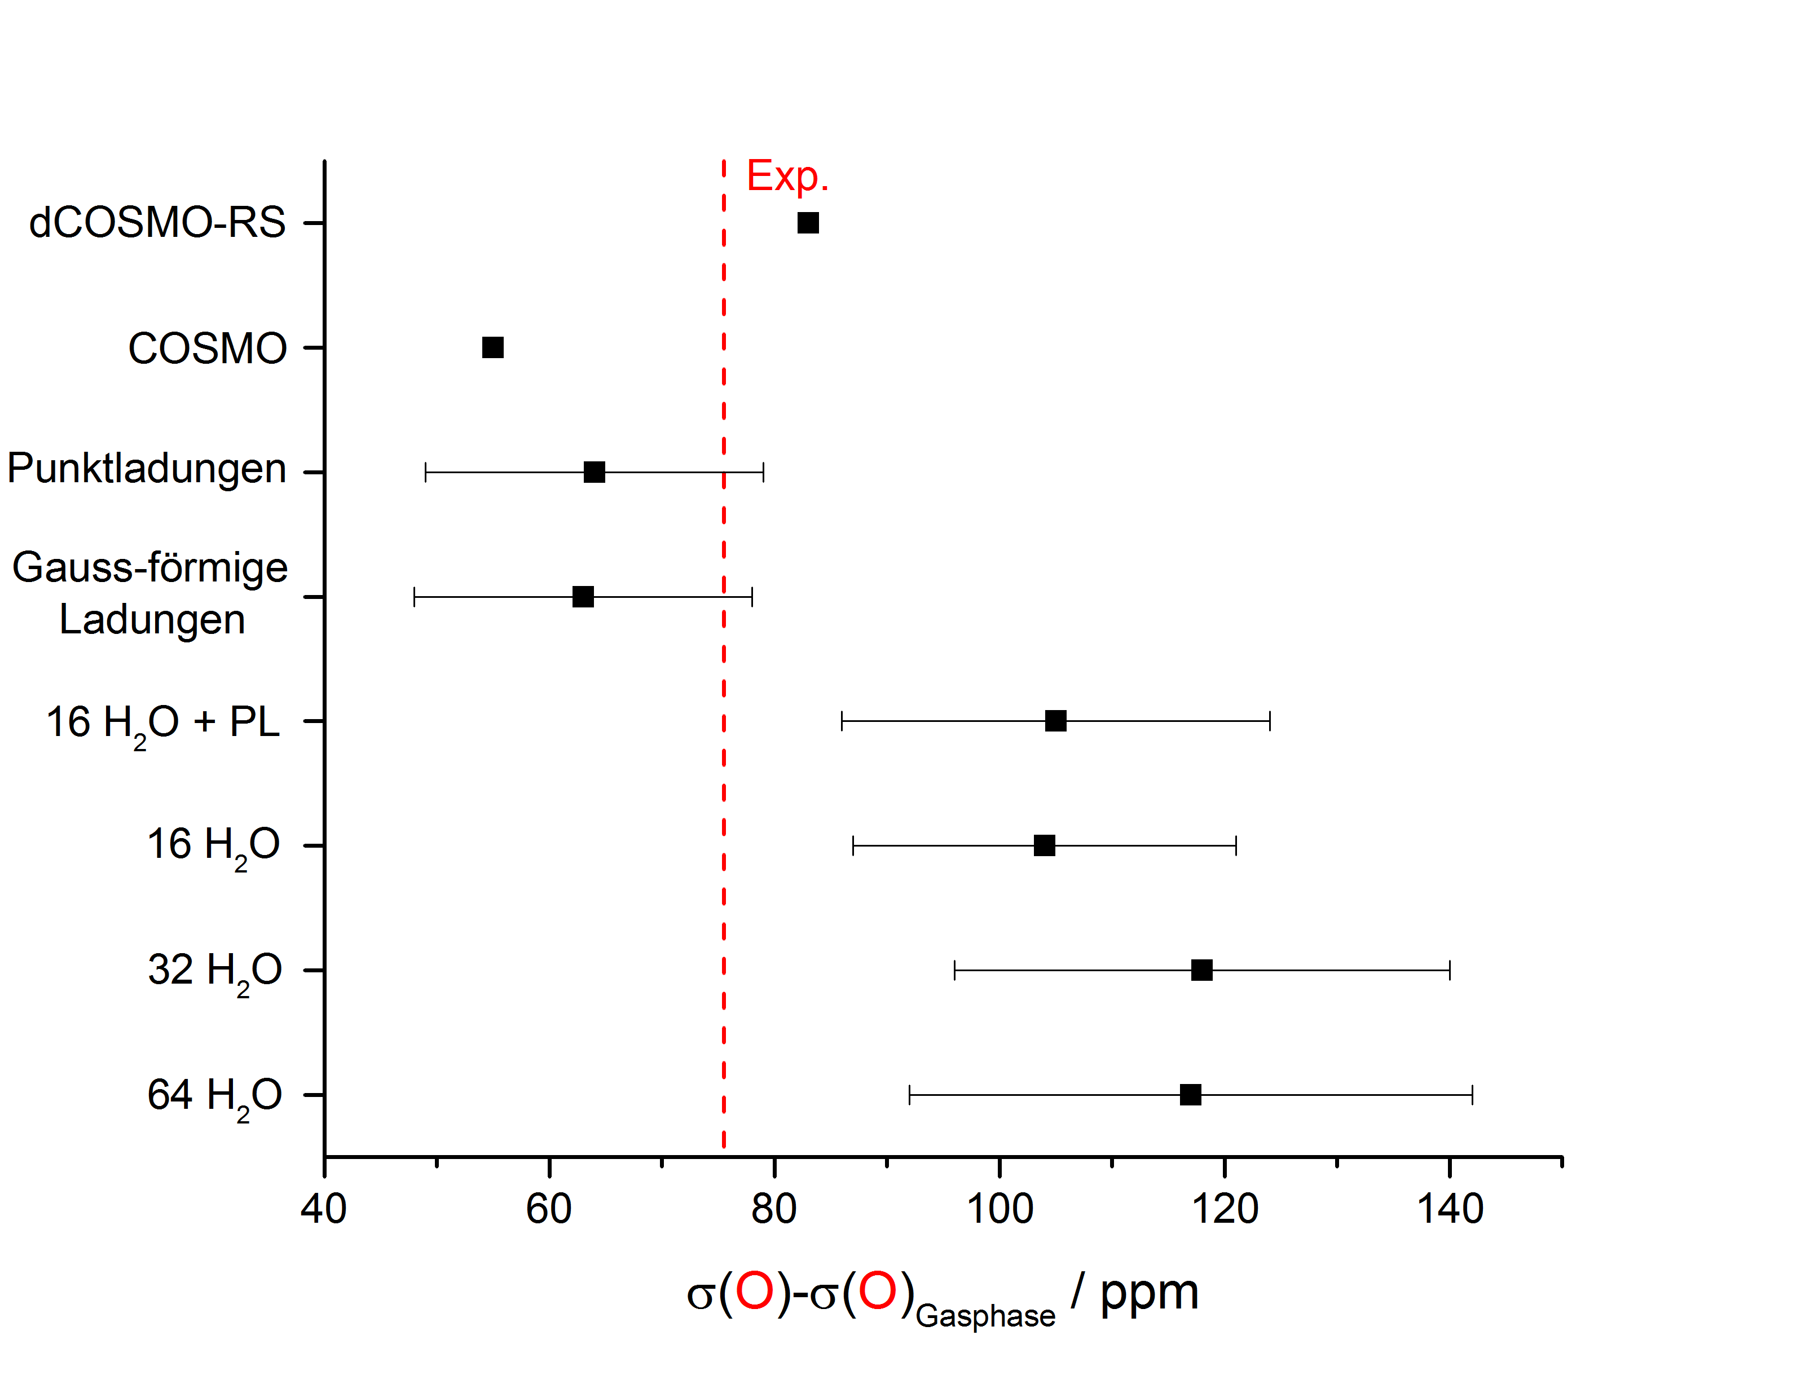
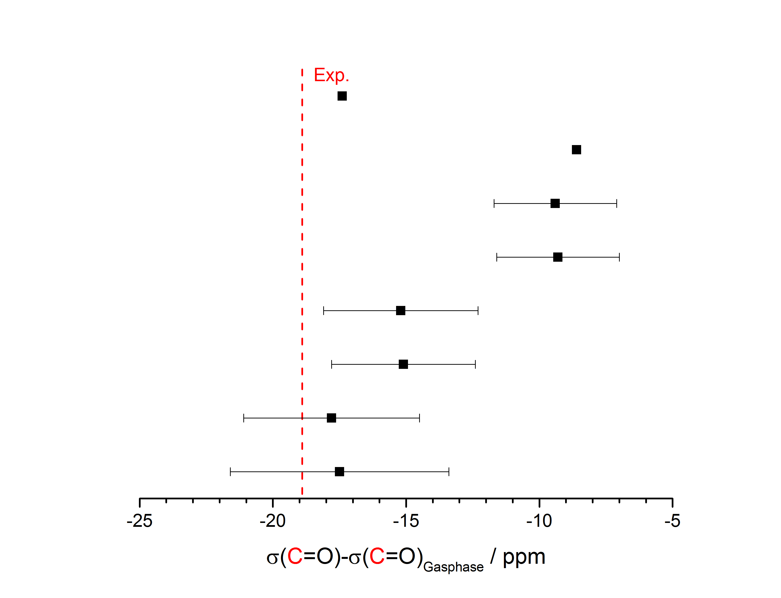
Acetone in water
[1]
[2]
σ(O), σ(C) : average over 100 snapshots (414 H₂O)
[1] M. Cossi, O. Crescenzi, J. Chem. Phys. 118, 8863 (2003)
[2] B. Tiffon, J. E. Dubois, Org. Magn. Res. 11, 295 (1978)

Slide 10
Efficiency: RI-J approximation (PB3)

Slide 11
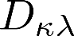
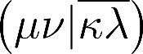
Efficiency (PB3): RI-J approximation
Derivative of two electron integrals w.r.t. the magnetic field
Coulomb part (formal O(N⁴) scaling behavior with the number of basis functions) is symmetric, is antisymmetric → second term vanishes

Slide 12
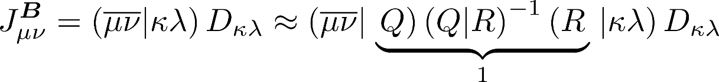
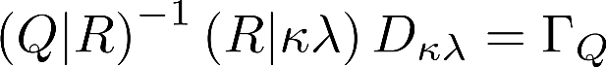
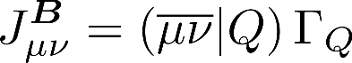
Efficiency (PB3): RI-J approximation
Resolution of the identity approximation: RI-J will be calculated in advance (like in ridft)
Final evaluation formal O(N³) scaling behavior with the number of basis functions

Slide 13
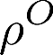
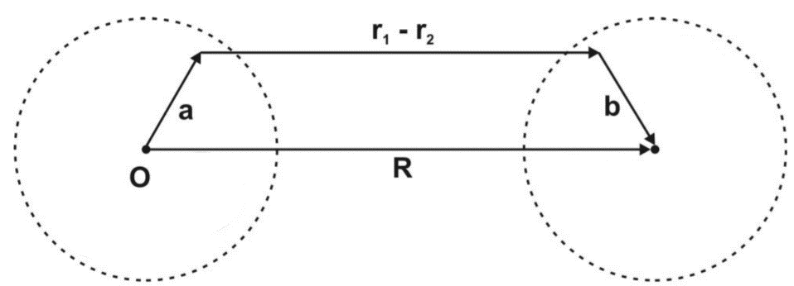
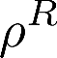
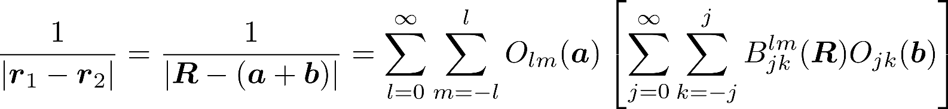
Efficiency (PB3): MARI-J approximation
Multipole accelerated resolution of the identity approximation: MARI-J Coulomb term is divided in a near-field (NF) and far-field (FF) part
NF part is evaluated by the RI-J approximation
FF part: Multipole approximation given by White and Head-Gordon:
M. Sierka, A. Hogekamp, R. Ahlrichs, J. Chem. Phys. 118, 9136 (2003).

Slide 14
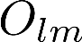
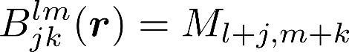
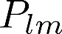
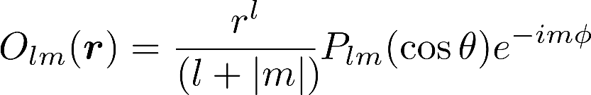
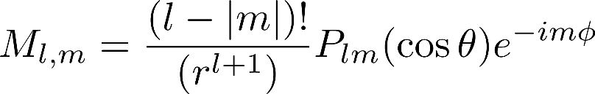
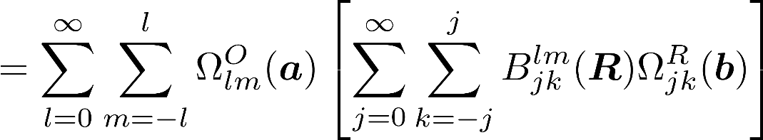
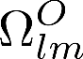
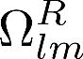
Efficiency (PB3): MARI-J approximation
and are defined in terms of Legendre polynomials
ρ^{Q} are atom centered charge distribution located at position Q
Coulomb interaction J_{OR} of two charge distributions ρ^{O} and ρ^{R} can be factorized
and are the multipole moments located at O and R
M. Sierka, A. Hogekamp, R. Ahlrichs, J. Chem. Phys. 118, 9136 (2003).

Slide 15
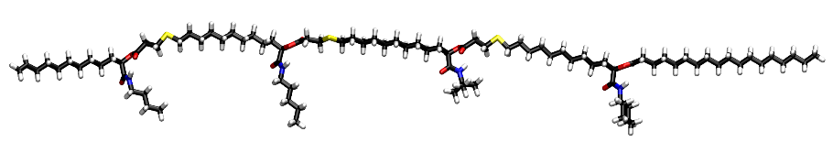
Efficiency (PB3): application I
Method: PBE/def2-TZVP
C₉₄H₁₇₄O₁₂N₄S₃ (287 atoms, 4565 basis functions)
CPU time
 | total | speedup | Coulomb part | speedup
Energy (MARI-J) | 42min
NMR | 5h43min |  | 5h16min
NMR (RI-J) | 51min | 6.7 | 22min | 14.3
NMR (MARI-J) | 33min | 10.4 | 5min | 66.3

Slide 16
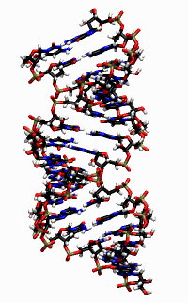
Efficiency (PB3): application II
COSMO application for a highly negatively charged DNA sequence
Method: PBE/def2-SV(P)/COSMO
[C₃₀₄H₃₄₆O₂₂₀N₁₁₈P₃₀]³⁰⁻ (1018 atoms, 10220 basis functions)
CPU time
 | total | speedup | Coulomb part | speedup
Energy (MARI-J) | 9h 52min
NMR | 43h 11min |  | 36h 9min
NMR (RI-J) | 10h 42 min | 4.0 | 3h 25min | 10.6
NMR (MARI-J) | 7h 38min | 5.7 | 20 min | 106.7

Slide 17
Efficiency (PB3): Accuracy of RI-J (MARI-J) and gauge invariance
difference between conventional mpshift and RI-mpshift for a small testset: CH₄, C₂H₆, C₂H₄, C₂H₂, CH₂O₂, C₂H₆CO, C₃H₈, C₄H₁₀, C₅H₁₂, C₆H₆, naphthaline, azulene, ferrocene, PMe₃, PPh₃, SiMe₄
mean absolute deviation maximum deviation H 0.00099 0.00689
C 0.05639 0.31802
def2-TZVP/BP86

Slide 18
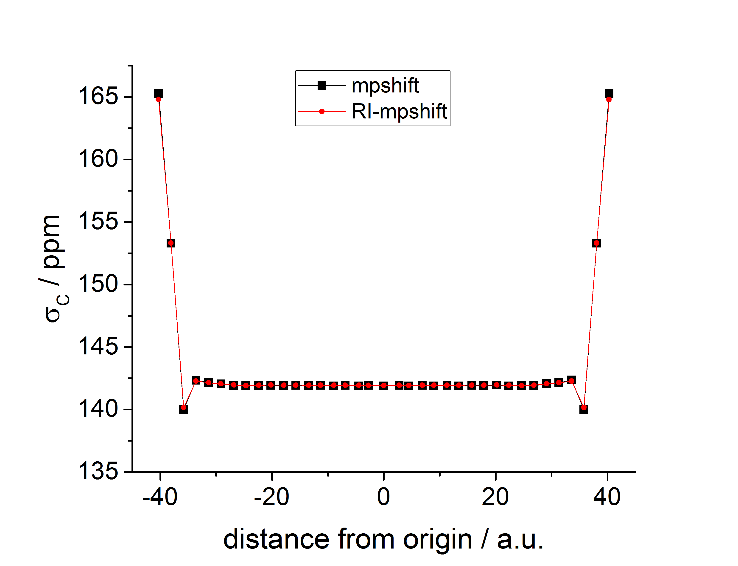
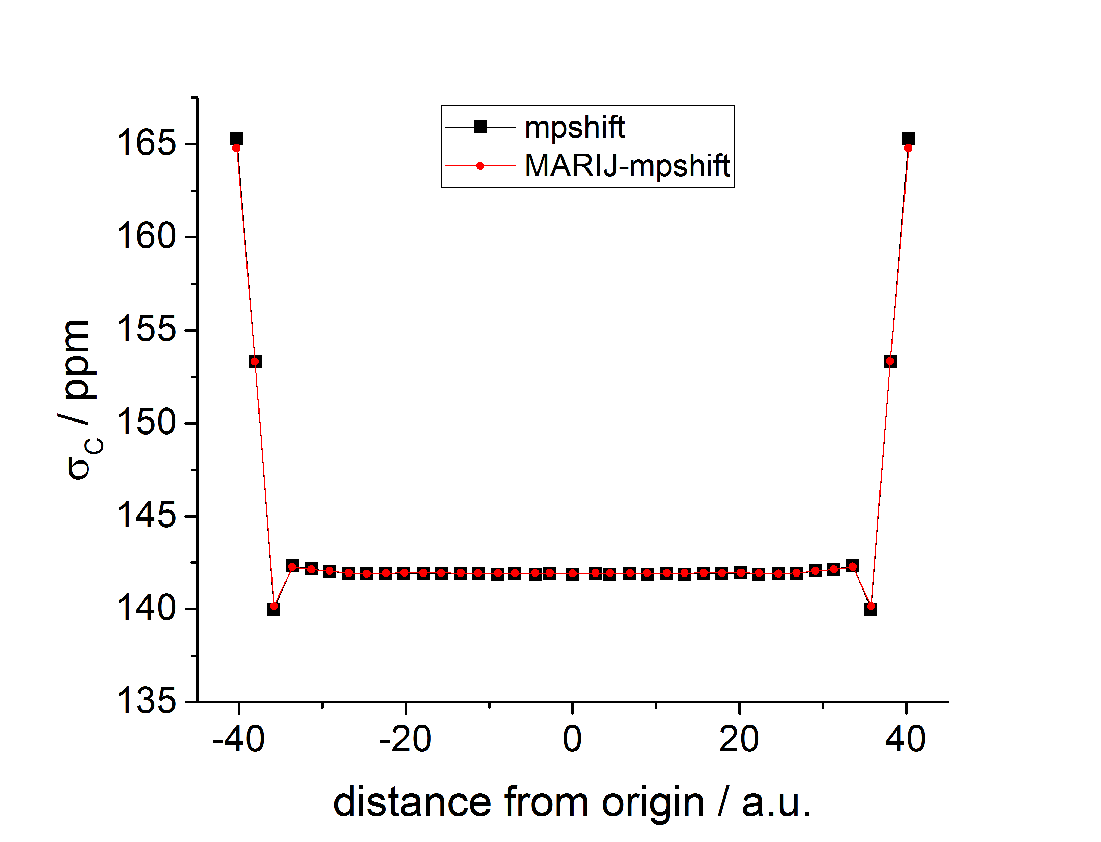
Efficiency (PB3): Accuracy of RI-J (MARI-J) and gauge invariance
Alkane chain with central C atom in the origin: comparison between conventional mpshift and RI-mpshift (def2-TZVP/BP86)
39 min 4 s
6 min 49 s
39 min 4 s
5 min 29 s

Slide 19
Q5-B Further development of TURBOMOLE´s NMR module: outlook
PB3: efficiency: RI-J + MARI-J approximation (symmetry)
+ linear-scaling DFT routines (+meta-GGA-functionals) + parallelization
PB4: all electron relativistic (outlook at the 2nd period)
NMR-related cooperation

Slide 20
Acknowledgement
Florian Weigend
DFG for funding
Thank you for your attention!

